Slide 1


Data Collection
Data Exploration
THE DATA'S
JOURNEY
Cleaning &
Normalization
Analysis
Hypothesis
Validation
Notes:
b

Slide 2


FINAL PART OF OUR JOURNEY
EXPLORATORY DATA ANALYSIS
DATA COLLECTION
DATA ANALYSIS
MODEL EVALUATION

Slide 3

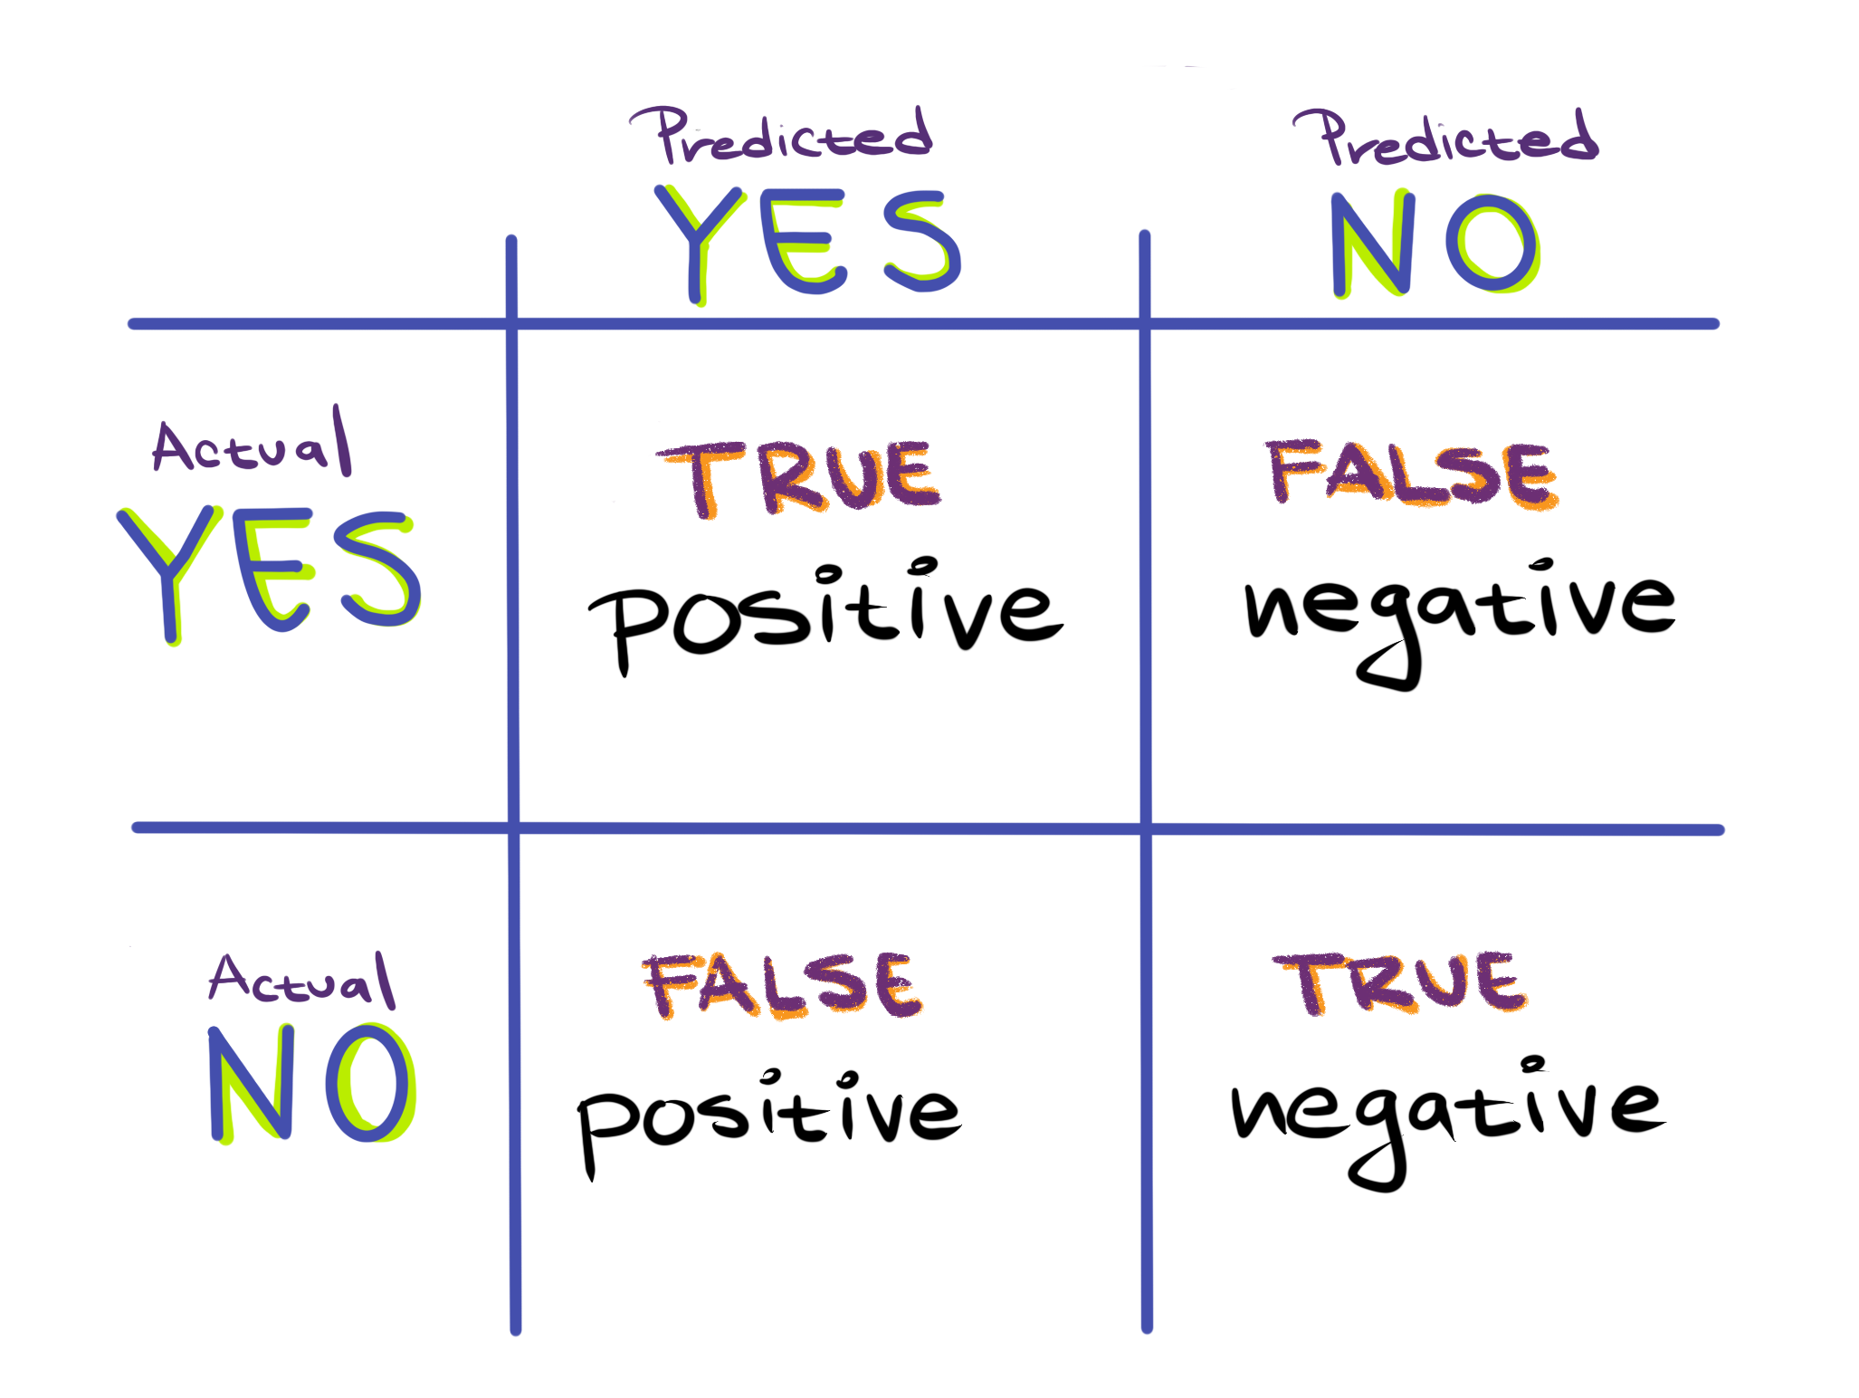
MODEL EVALUATION
GOOD
How do we measure the performance of a model?
How much/far can we trust the results we have obtained?
How do we interpret the results of the evaluation?
Let the RQ, data and model pick the evaluation metric
BAD
Notes:
Every type of model has their own criteria by which we evaluate

Slide 4
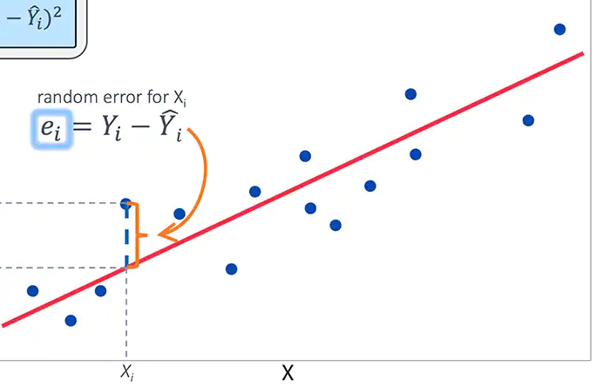
MODEL PERFORMANCE
How well does the model fit the data?
Criteria depend on model type
Good models capture the underlying trends and characteristics
PERFORMACE METRICS:
R-squared
MSE
RMSE
RMSLE
REGRESSION
Accuracy
Precision
Recall
ROC/AUC
CLASSIFICATION
Silhouette
Adj. Rand Indx.
Gap statistic
Davies-Bouldin
CLUSTERING
Notes:
RMSE == Root Mean Squared Error
Relevant for models that have parameters you can choose: regression, classification (not t-test).
The two questions are not the same.
How well does the model fit?
For regression that could be least squares (distance of data points to fitted line)
Good model captures underlying trends and characteristics of the data
Can estimate deviations by goodness-of-fit
For clustering we can evaluate whether the number of clusters we have chosen is optimal
If we did kmeans we may discover the ideal number of clusters using the elbow method:
Different measures to describe “how much are the points in a certain cluster more similar between themself than with the points in different clusters?”
The measures, also called clustering evaluation techniques, are: silhouette score, calinski harabasz score, davies bouldin score. There may be others
We use this to score the goodness/usefulness of the clustering and pick the number of clusters with the highest measure
However, we do not want a perfect fit! Because data always has noise, if the model fits the data too well it will become very poor at doing the actual task (classification) and we get overfitting.
Therefore, we evaluate separately how well the model performs on the task.

Slide 5
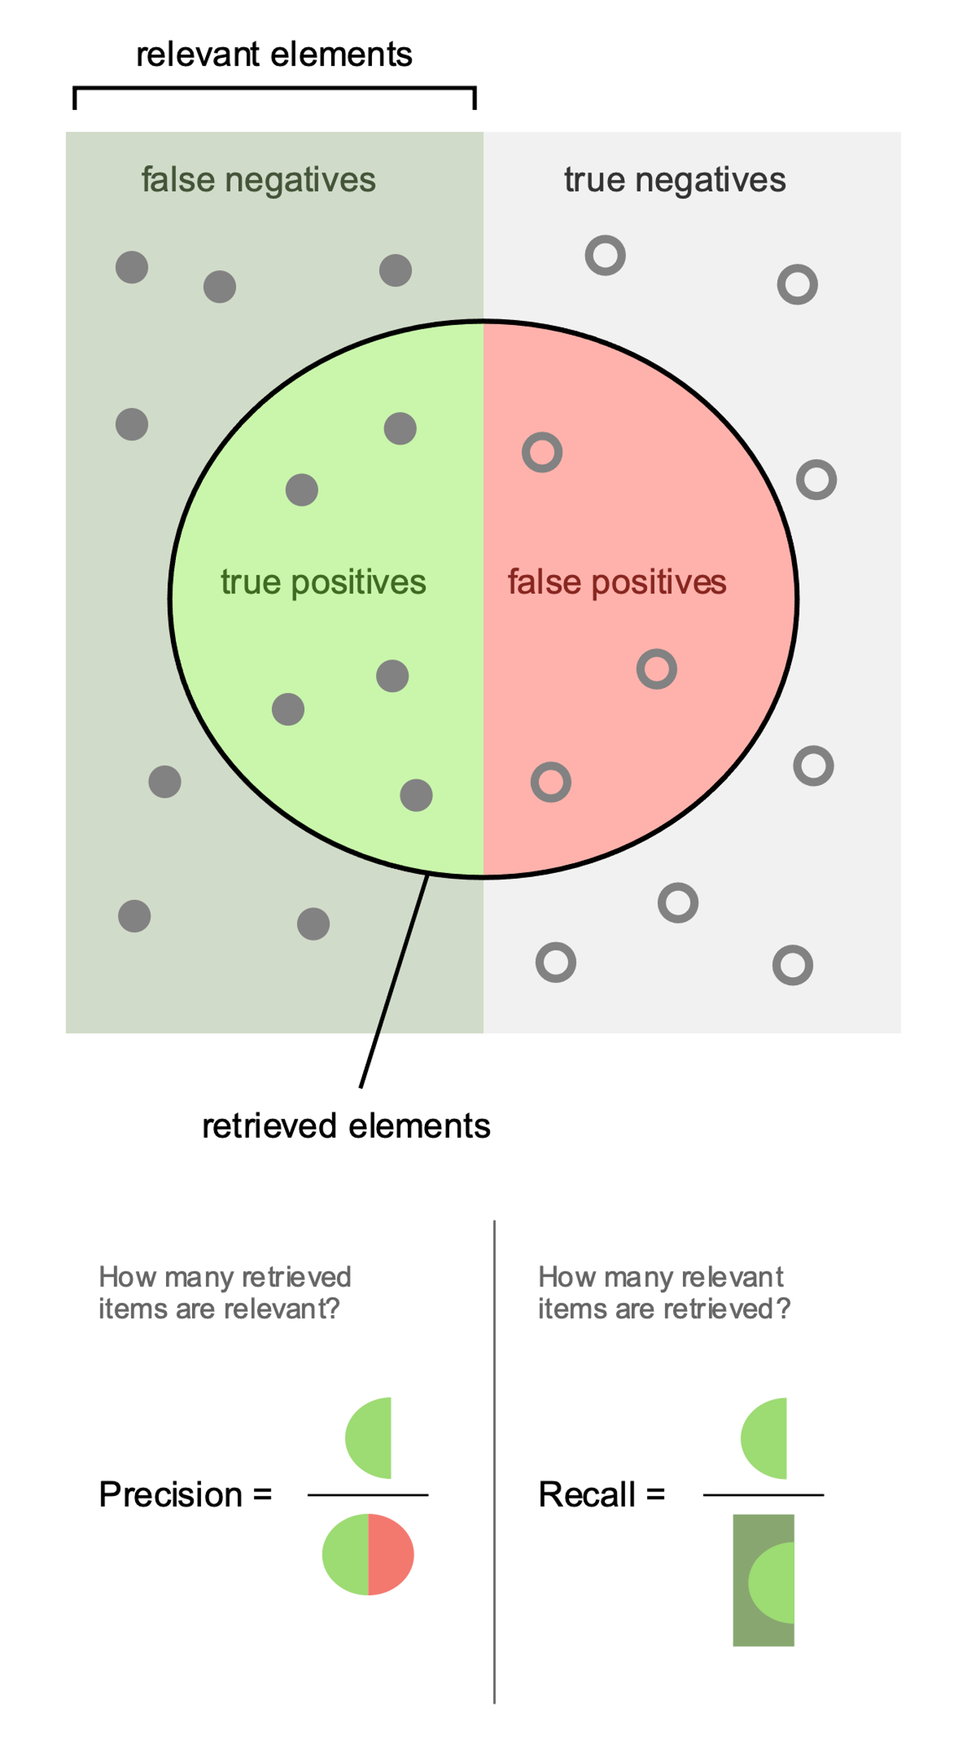
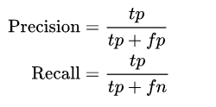
CLASSIFIER
PERFORMANCE
Classifiers performance is measured in several ways.
Performance measures like precision and recall depend on how many elements we choose to retrieve.

Slide 6
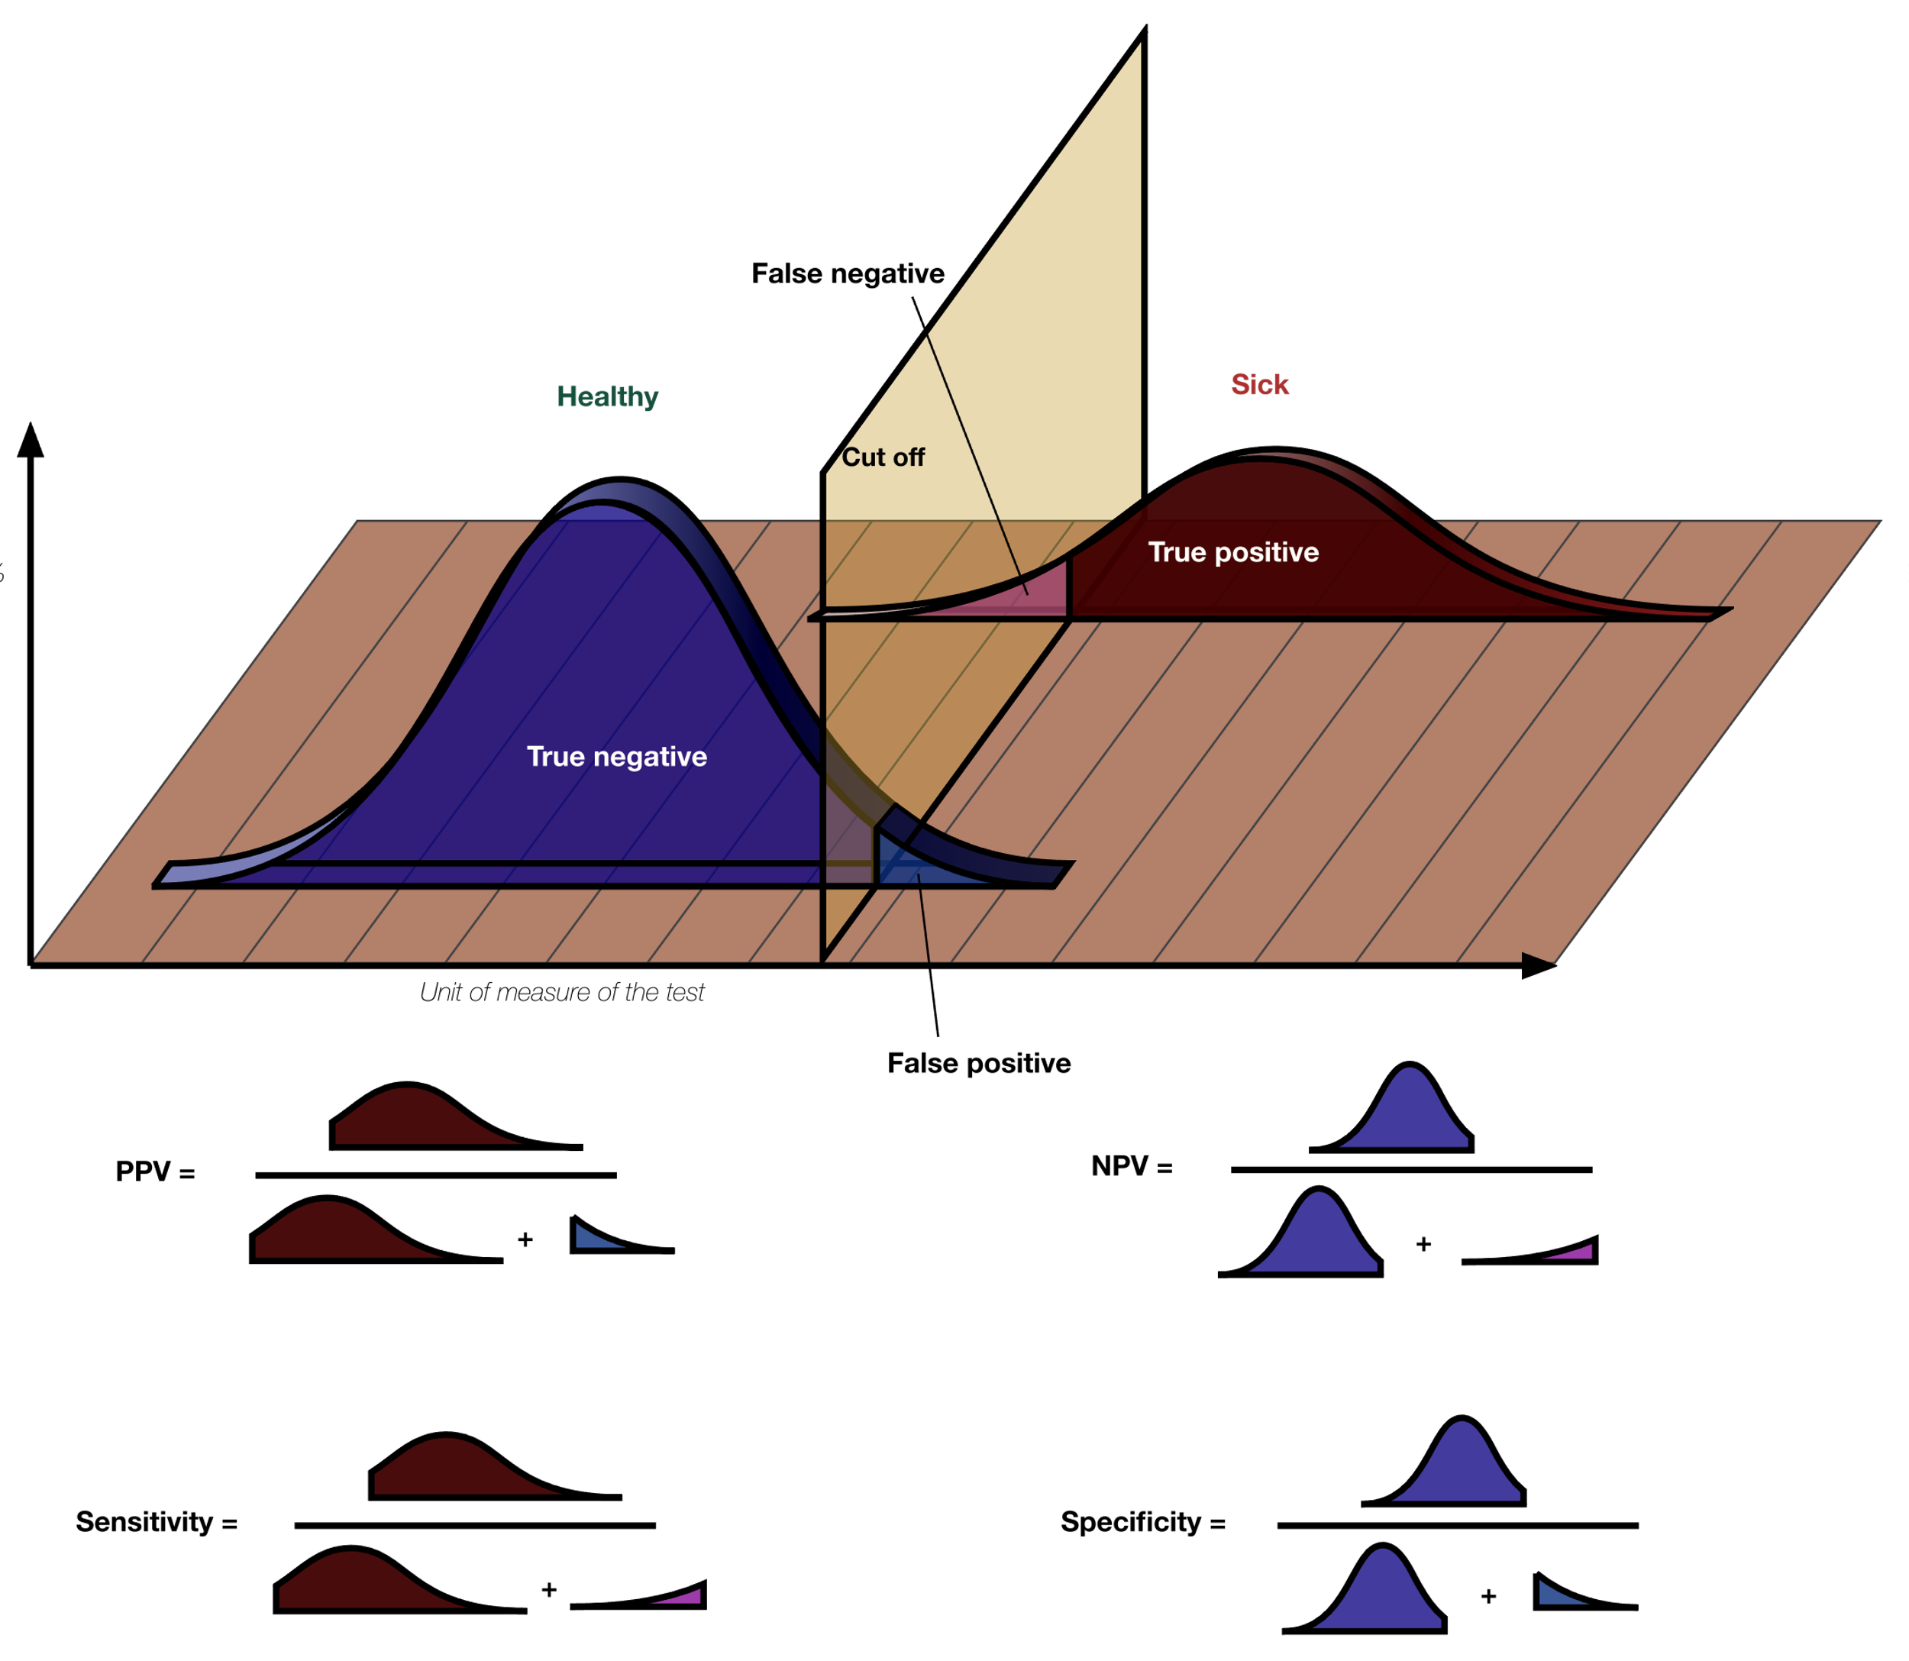
CLASSIFIER
PERFORMANCE
Performance measures of classifiers depend on the chosen cutoff.
One can easily optimize on the number of false positives or false negatives, but not both at the same time.
Precision :
Recall/
True positive rate
Notes:
Precision == the ratio of true positive predictions to the total number of positive predictions made by the model.
Specificity == the ratio of true negative predictions to the total number of actual negative cases in the data.
Recall (sensitivity)== the ratio of true positive predictions to the total number of actual positive cases in the data.
Accuracy == the ratio of correctly predicted cases (both true positives and true negatives) to the total number of cases.
There is often a trade-off between precision and recall. Increasing one metric may lead to a decrease in the other. It depends on the specific threshold set for the model to classify predictions as positive or negative.
In the Context of Disease Diagnosis:
High precision is important when the consequences of a false positive prediction are significant, as it minimizes the chances of unnecessary treatments or interventions.
High recall is crucial when the consequences of a false negative prediction are severe, as it minimizes the chances of missing actual cases of the disease.
F1 Score: To balance precision and recall, the F1 score, which is the harmonic mean of precision and recall, is often used. F1=2×Precision×RecallPrecision + RecallF1=Precision + Recall2×Precision×Recall​

Slide 7
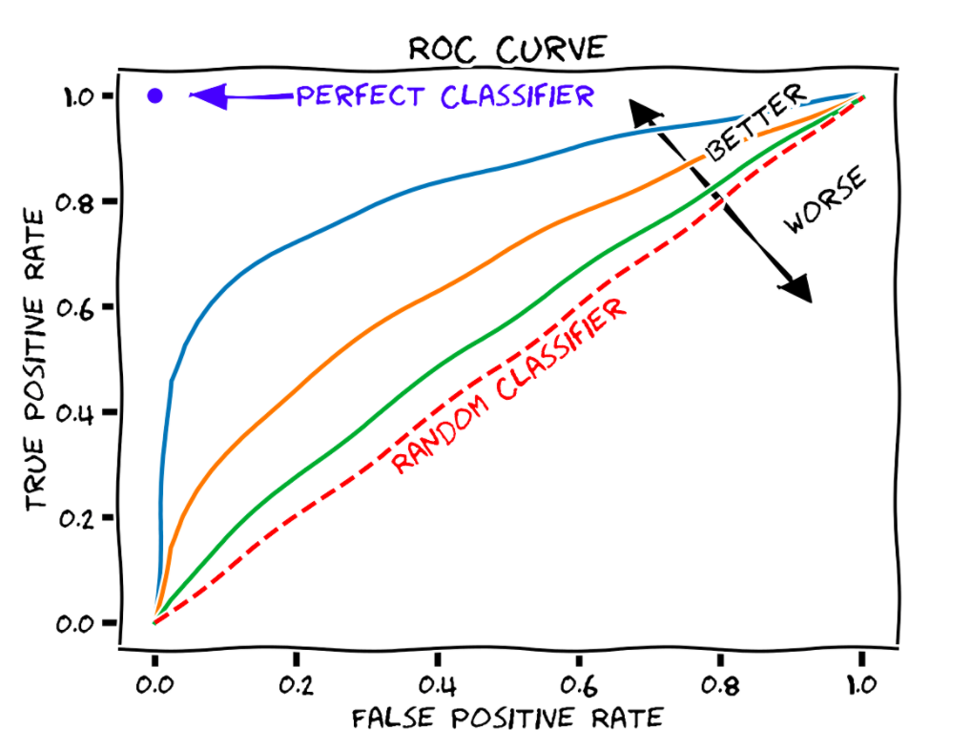
AREA UNDER THE CURVE (AUC)
This is why we use the AUC to report on the goodness of the classification.
Receiver Operator Curve (ROC)
Plotted by using every possible cutoff.
Each True Positive Rate has an associated False Positive rate.
How many of the true cases have we discovered?
Notes:
In terms of classifiers we always have the trade-off between true-positive and false-positive rates:
If we want few false positives (people predicted to have cancer though they are healthy), we will also have more false negatives (cancer people predicted to be healthy)
If we want to miss as few cases as possible, we will have a high amount of false-positives.

Slide 8


GROUP DISCUSSION
For a medical screening procedure to detect a disease, what does each of these terms correspond to:
True positive
False positive
True negative
False negative
On the right you have the formulas for precision and recall.
Which one do you prefer to optimize for a screening program?

Slide 9
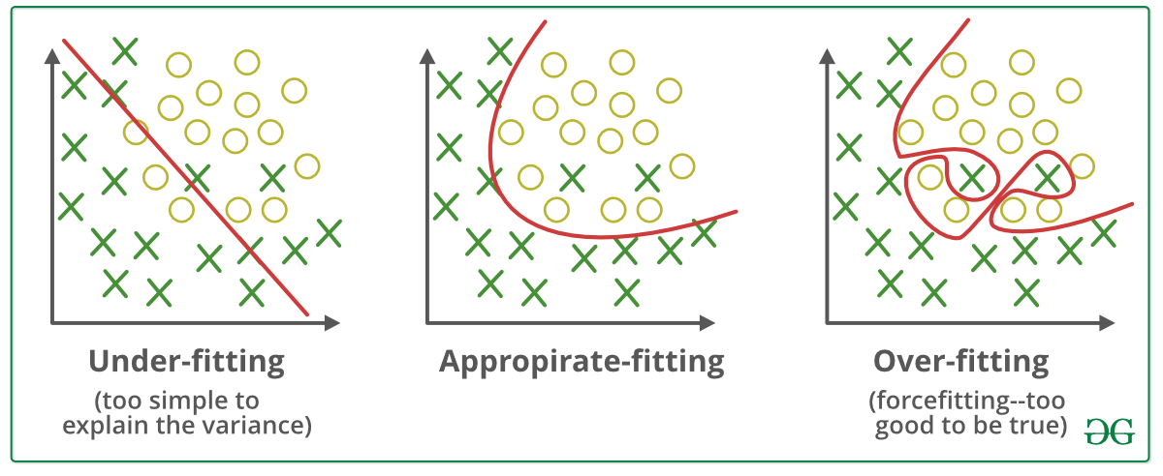
OVERFITTING
Data
Train
Eval
When a model follows the data too closely we get an effect known as overfitting.
We avoid this by splitting the data into training and evaluation sets.
Eval
Cross Validation
Eval
Eval
Notes:
Relevant for models that have parameters you can choose: regression, classification (not t-test).
The two questions are not the same.
How well does the model fit?
Every type of model has their own criteria by which we evaluate
For regression that could be least squares (distance of data points to fitted line)
For clustering we can evaluate whether the number of clusters we have chosen is optimal
However, we do not want a perfect fit! Because data always has noise, if the model fits the data too well it will become very poor at doing the actual task (classification) and we get overfitting.
Therefore, we evaluate separately how well the model performs on the task.

Slide 10
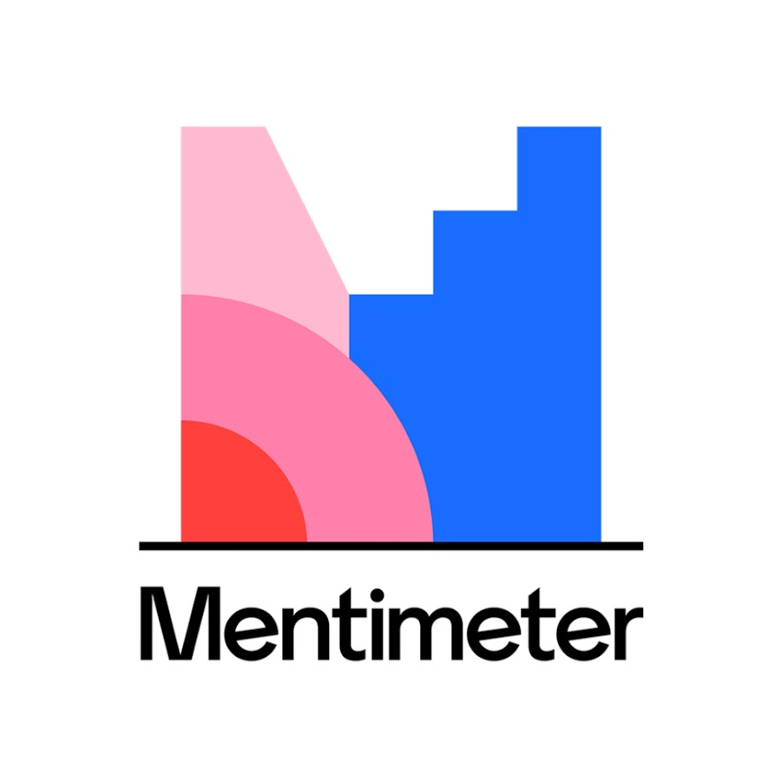

Have you used any of the models we’ve talked about in this section?

Slide 11
GROUP DISCUSSION
On your table you have a print-out in which the same data has been fitted with three different models (the red lines).
In your group, discuss which of these you think is the most suitable and why.
In general, what is the problem with high-dimensional model with many parameters?
Notes:
Overfitting linear regression picture
Why is the middle one better? Explain
What is the problem with having many parameters?
(What do the parameters mean? (reaction rate))
Discussion:
How would be your error term for regression with two data points, large or small?

Slide 12
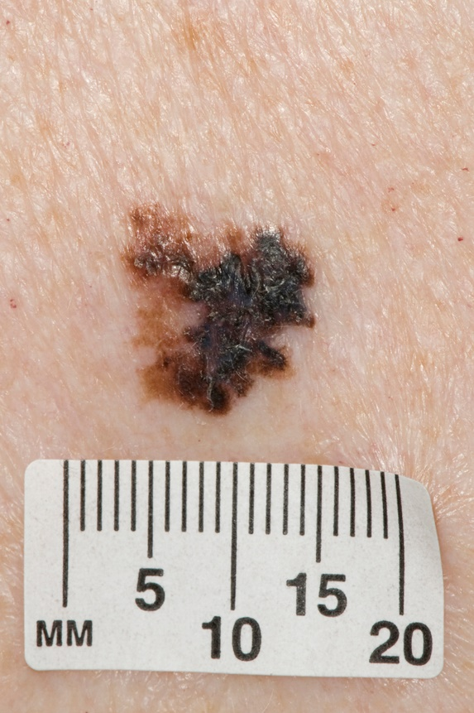



BIASES
What biases could have influenced the results?
Bias arises primarily from how the data was gathered and processed.
Bias can reduce model validity, i.e. a model trained in one population may not work in another.
?
Notes:
Output reflects input -> poor quality data results in poor performance
Rarely are both models and data free of biases.
Bias is different from accuracy. It is a skew in the data cause by collection or processing. Generally the term error refers to the outcome and the term bias refers to the process. (https://en.wikipedia.org/wiki/Bias_(statistics) )
Other examples:
If all photos of malignant melanoma have a ruler in them and the normal skin spot photos do not
Bias:
does data include elements that the model should be ignorant of?
The way training is set-up (objective function)
The way the model is set-up (parameters, design choices) -> algorithmic bias

Slide 13
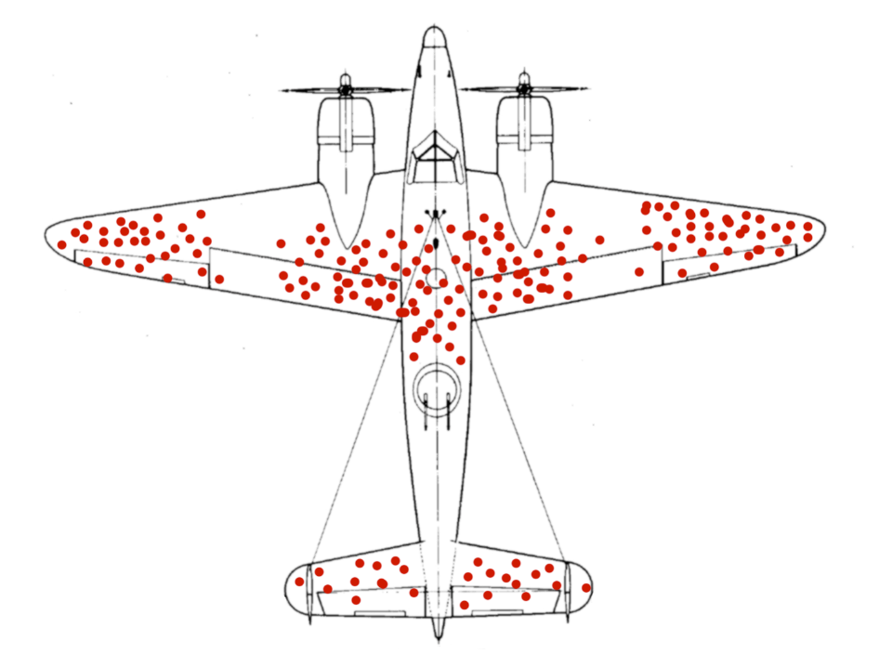
GROUP DISCUSSION
Consider the following schematic of bullet holes on returning WW2 planes.
It shows with red circles where each plane was struck.
Bases on this data, which part of the plane do you think should be reinforced to better protect the plane from being damaged?
Notes:
What kind of data types do you and your collaborators work with?
What would you like to work with?
Which of the roles we have introduced do you see yourself in?
Do you have people in your group or among your collaborators to fill the other roles? If not, what are alternatives?

Slide 14
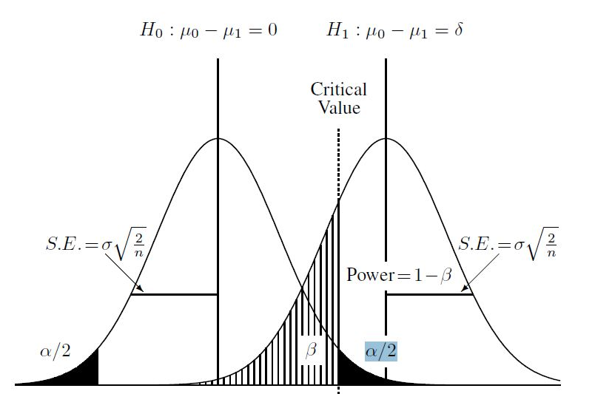
WHAT DO THE RESULTS MEAN?
Hypothesis testing
Classification / Prediction
A significant p-value
supports the rejection of the null hypothesis.
Poor model performance, the model does not capture the data pattern.
Interpretable parameters?
Coefficients/Feature importance tell which predictor variables have a large influence in outcome
Regression model:
birth weight ~
mother’s weight + smoking +
mother’s age
Avg life exp.
Cigarettes smoked
Notes:
hypo test + pred -> can interpret results directly.
In hypothesis testing the meaning is mainly answering our question.
Is birthweight sig. different between mothers who smoke and non-smokers, yes or no?
Parameters have a meaning, i.e. slope and intercept in a regression model.
If our model is average live expectancy (y) VS cigarettes smoked (x) then the intercept is the life expectancy at 0 cigarettes and the slope is how much life expectancy decreases for one unit of cigarette smoking.
Though the intercept sometimes doesn’t have real life meaning (if x cannot meaningfully be 0, the y-intercept has no useful interpretation).
Example: birth weight ~ mother’s weight + smoking + mother’s age
Coefficients tell us which of these have the largest influence and we can test whether we should drop (not consider) one or several
In a random forest the feature importance takes the roll of the coeff
If model performance is bad that means we cannot answer our question/build a good predictor with the data we have which is also an insight

Slide 15
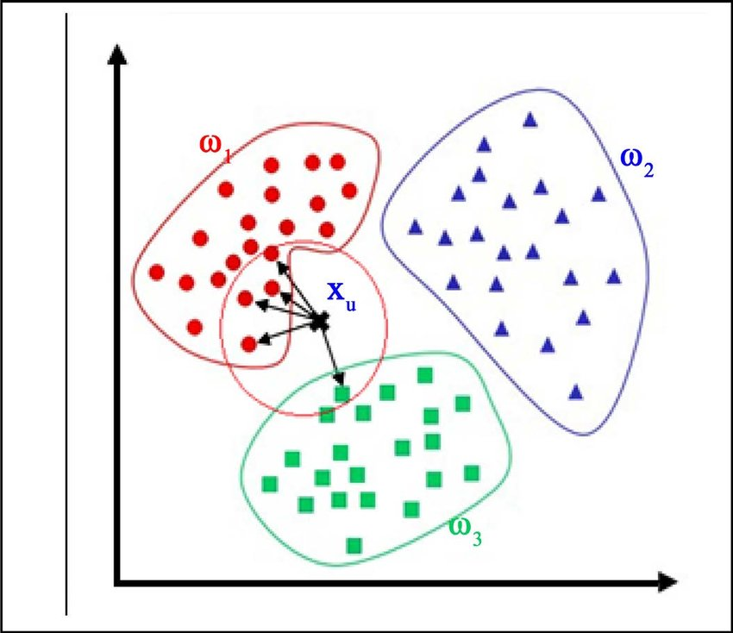
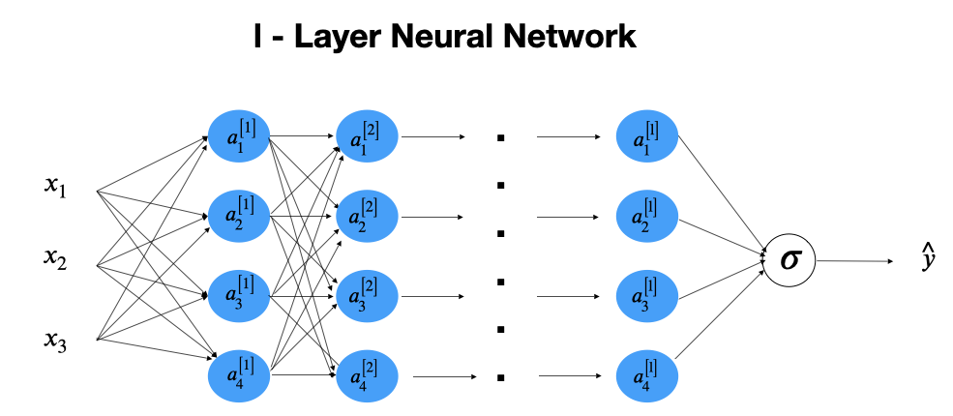
WHAT DO THE RESULTS MEAN?
Unsupervised Learning/Clustering
Black Box models
Insights about the structure of the data, esp. number of clusters
Further analyse properties of discovered clusters (biological meaning)
Highly non-linear models with many parameters are difficult to interpret
We mostly use the performance instead of trying to gain insights
Predict cluster membership of new data points
Notes:
Clustering:
- Cannot evaluate performance without ground truth
If it’s black box models: many parameters and non-linearity, for example neural network, tSNE, its more difficult
Cannot directly interpret results
Very difficult to know why the model gives a certain answer (why is this skin spot cancerous?) and therefore we do not understand what the model has learned
Performance is good, insights are few
What do results from clustering mean?
We don’t have ground truth so we can’t eval performance as in supervised learning.
I guess we have learned something about the structure of the data
If we did kmeans we may discover the ideal number of clusters using the elbow method:
Different measures to describe “how much are the points in a certain cluster more similar between themself than with the points in different clusters?”
The measures, also called clustering evaluation techniques, are: silhouette score, calinski harabasz score, davies bouldin score. There may be others
We use this to score the goodness/usefulness of the clustering and pick the number of clusters with the highest measure

Slide 16
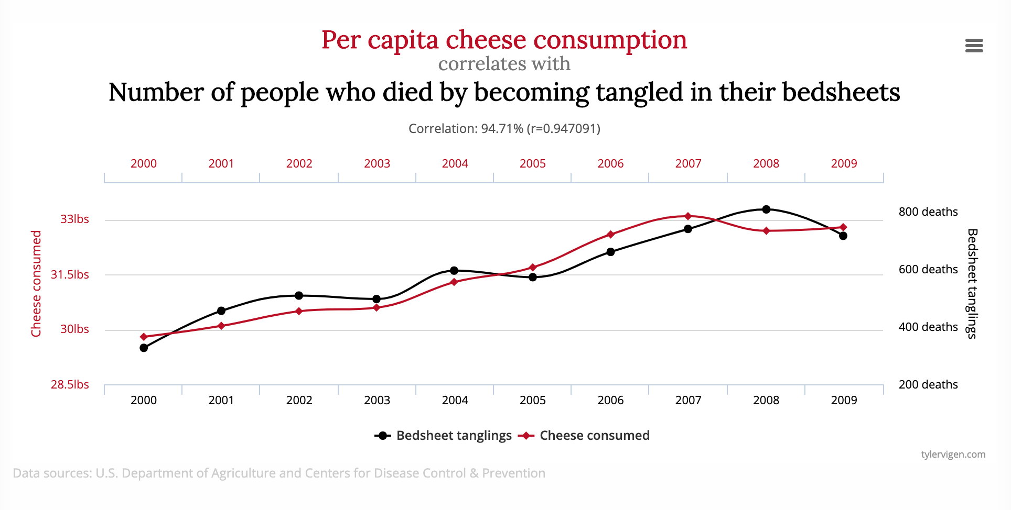
CORRELATION ≠ CAUSATION
One goal of modelling is to discover relationships between predictor and outcome variable.
However, modelling is not primarily concerned with causality.
If our model shows that a relationship exists, that does not mean the relationship is causal.
Notes:
Predictive power of A over/towards B does not mean that A causes B.
Add example
Example:
We know now that smoking increases risk of heart disease as well as cancer.
If we did not know, we might find an association between heart disease and cancer. However, treating heart disease does not reduce cancer rates because heart disease does not cause cancer. They are both caused by another, underlying problem/property.
Therefore, mode of action is important to causality. How does A cause B and does that makes sense in the framework of known biology?

Slide 17
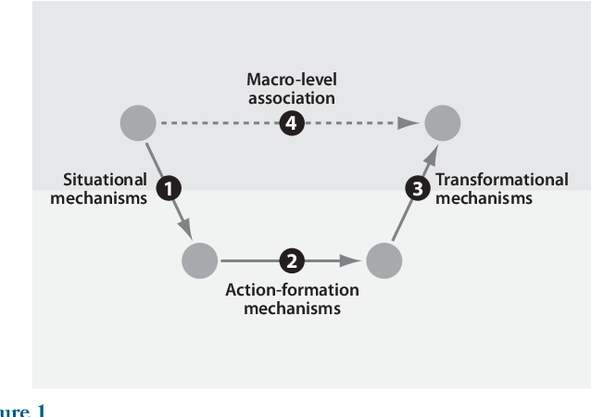
THE QUESTION OF CAUSALITY
Where does this leave us?
Causality can only be surmised in the statistical framework of causal inference.
Mode of action is vital.
If A causes B, how so?
Does that make sense in the framework of existing domain knowledge?
Hedström, P. and Petri Y. " Annual review of sociology 36 (2010): 49-67.
Causality can be shown by gathering convergent evidence from different lines of inquiry and direct cause-effect experiments (animal/cell studies).
Notes:
Domain expert -> do these results make sense?
Researchers are always interested in causality
However only recently have these kinds of questions even become available in a stats framework with the advent of causal inference
Must propose Mode of action for causality (how does A cause b), rooted in biology/domain knowledge -> domain expert
Gene expression -> interpretability?
From a practical point of view, mode of action is vital. If A causes B, how so? And does that make sense in the framework of existing domain knowledge? -> Domain experts
Afterwards, new experiments must be devised to confirm or deny the hypothesis that A causes B. -> I thought you cannot prove that? Well, not without intervention data
How was it proven that smoking causes cancer? Is mode of action enough? Mouse model? Cell culture?
Well, this is a bit a special case since people haven’t always smoked so the rise of cigarettes and of lung cancer coincided suspiciously. In a way, cigs are an ‘intervention’ in statistical language that is like to produce the cancer outcome.
-> so whats the difference to the idea that cell phones cause cancer? Those two rates also increased at the same time!
The population study was the indication which was later confirmed in animal experiments and by histology (looking at cells from smokers), though this is again not direct evidence
There was also a convergence from different lines of inquiry
Though if people with damage in the pulmonary cilia are more likely to smoke and also more likely to get cancer you would get the same result.
Afterwards, new experiments must be devised to confirm or deny the hypothesis that A causes B. -> convergent evidence from different lines of inquiry, trying to eliminate spurious correlations.

Slide 18
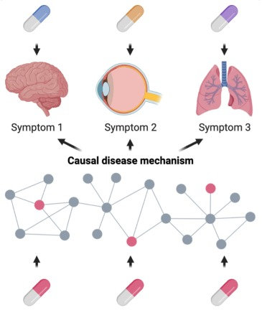
THE QUESTION OF CAUSALITY
Is causality always central in (Health) Data Science Analysis?
The answer is that it depends on what we are trying to achieve:
A question of causality:
YES: Underlying biological mechanism -> true treatment of disease
NO: Diagnosis of disease (causality is nice but not necessary)
Nogales, Cristian, et al. Trends in Pharmacological Sciences 43.2 (2022): 136-150.

Slide 19
GROUP DISCUSSION
In a cross-sectional study, researchers observed that the number of vaccinations a population received was positively associated with the prevalence of certain diseases.
In a cohort study, researchers found an inverse (negative) relationship between exercise and prevalence of arthritis in a group of individuals, i.e. less exercise more likely to be diagnosed with arthritis.
Discuss the two studies above and their conclusion, does vaccination cause an increase in disease development and does lack of exercise cause the development of arthritis? Think about confounders…

Slide 20
GROUP DISCUSSION
In a recent population study on alcohol consumption and cancer development, analysis revealed that people who often drink wine, have an increased risk of developing lung cancer compared to people who do not.
Does drinking wine cause lung cancer? Can you think of any confounding factors which could explain this correlation, i.e. life style choices, socioeconomic group, etc.?

Slide 21
OVERVIEW OF OUR JOURNEY
EXPLORATORY DATA ANALYSIS
DATA COLLECTION
DATA ANALYSIS
MODEL EVALUATION

Slide 22


HEALTH DATA SCIENCE – YOUR NEXT STEP
COURSES
DATA SCIENCE
COLLABORATION
ONLINE RESOURCES
HeaDS:
Programming (Python, R)
High performance compute.
Applied health DS analysis
Biostatistics
NNF Centers (ReNew, CPR)
SUND faculty
https://www.coursera.org/
https://www.codecademy.com
https://www.datacamp.com/
https://towardsdatascience.com/
Stack Overflow & Reddit
Books:
”R for Data Science”
“Python Data Science Handbook”, “Statistics for Health Data Science”
Conferences & seminars on DS
Matchmaking events
Contact relevant depart-ment, group, support -and core facility
R
< / >

Slide 23


The Digital Core Curriculum (DCC) initiative:
KU educations to include digital literacy and data science competences
DS in Medical Research is the future!
As a domain expert, so what is your role?
Form a collaboration with a data scientist
Encourage your staff to take DS courses
Know where to get help with DS analysis
Notes:
Started in 2019 at SUND by vice dean of education Hans Henrik Saxild
Then taken up by KU board of directors and implemented KU wide
Sund is 1 year ahead of the rest of the faculties in the process. Some departments and institutes are further in the process than others.
The 5 – 7,5 ECTS can be one or two new, specific courses or DCC can be integrated into existing courses
Future-proof educations at KU by adding digital competences, also in the formal learning objectives and give graduates the skills they need to succeed in research careers as well as the job market

Slide 24

DATA SCIENCE IN YOUR TEACHING
Could you incorporate more data science in your teaching?
Take courses and learn yourself
Get inspired by colleagues
Collaborate with colleagues in DS on course materials
Start a little at a time:
Move from Excel → R or Python
Think about old analysis and RQs in a new ‘DS light’
Encourage your students to explore DS tools (Github, Programming, HPC)
Get familiar with ChatGPT

Slide 25
GROUP DISCUSSION
What is your main take away from today?
Has what your have learned today changed your perspective on Data Science?
How do you think your future relationship to Data Science will be?
In what ways can you incorporate Data Science thinking into your teaching?
Notes:
Closing thoughts/ discussion:
What do you take away
What is your most important take away from today?
How does it change your view on DS?
How does it change your teaching
How could you incorporate this in your teaching?
Is there anything in this workshop that opened your eyes?

Slide 26
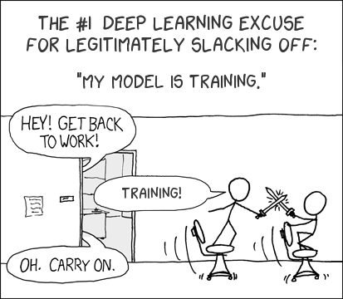
THANK YOU

